Slide 1
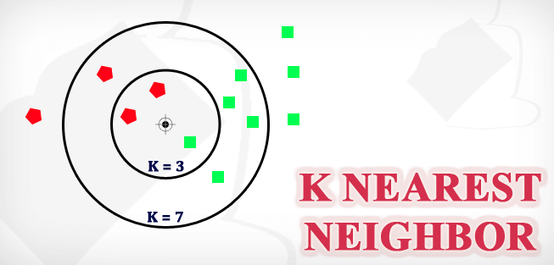

Slide 2
About:
The name of the algorithm, originates from the philosophy of kNN – i.e., people having similar mindset tend to stay close to each other.
In the same way,as a part of knn algorithm,the unknown and unlabelled data which comes for a prediction problem is judged on the basis of training data set of elements which are similar to the unknown elements.
k in kNN algorithm represents the number of nearest neighbor points which are voting for the new test data’s class.

Slide 4
Steps :
Load the data
Initialize K to your chosen number of neighbors
For each example in the data
->Calculate the distance between the query example and the current example from the data.
->Add the distance and the index of the example to an ordered collection
Sort the ordered collection of distances and indices from smallest to largest (in ascending order) by the distances.
Pick the first K entries from the sorted collection.
Get the labels of the selected K entries,then return mode of the lables
setting K-Nearest Neighbor algorithm forms a majority vote between the K most similar instances to a given unseen observation.

Slide 5
kNN Algorithm Manual Implementation

Slide 7
predict the T-shirt size of Anna, whose height is 161cm and her weight is 61kg.

Slide 8
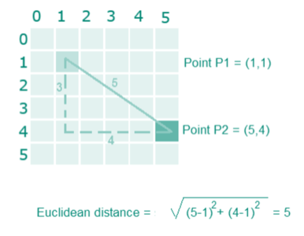
Step1: Calculate the Euclidean distance between the new point and the existing points For example, Euclidean distance between point P1(1,1) and P2(5,4) is:

Slide 10
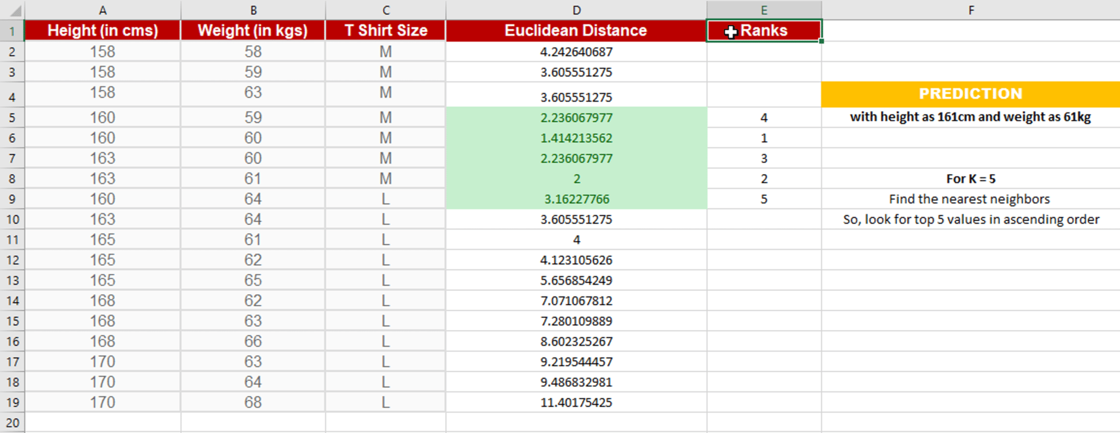
Step 2: Choose the value of K and select K neighbors closet to the new point.
In this case, select the top 5 parameters having least Euclidean distance

Slide 11
Step 3: Count the votes of all the K neighbors / Predicting Values
Since for K = 5, we have 4 Tshirts of size M, therefore according to the kNN Algorithm,
Anna of height 161 cm and weight, 61kg will fit into a Tshirt of size M.

